Slide 1
Mathematical Terms and Theory

Slide 2
Content
1.1 Sets
1.2 Functions
1.3 Logical statements
1.4 Proofs, Relations, Languages
1.5 Mathematical induction,
Strong principle,
Recursive definitions

Slide 3
Content
1.1 Sets
1.2 Functions
1.3 Logical statements
1.4 Proofs, Relations, Languages
1.5 Mathematical induction,
Strong principle,
Recursive definitions

Slide 4
Set representation
Finite set can be describe by listing its elements
  e.g. A = { 1 , 20 , 50 , 60 }
If set is having more elements or for infinite set ellipses (…) are used
  e.g. A = { 1 , 2 , 3 , … , 100 }
  B = { 1 , 2 , 3 , … }

Slide 5
Set representation
It can describe by its property
  More informative
  More reliable
  e.g.
  A = { 0, 2 , 4 ,6 , 8 , 10 , … }
  can be described as
  A = { x | x%2=0 and 0<= x }
  can also be described as
  A = { 2x | x is non negative integer }

Slide 6
Set representation
Set of set
  e.g. A = { {x , x+1} | x is non negative integer such
  that x>=4}
  A = { {4,5} , {5,6} , {6,7} , {7,8} , …}

Slide 7
Predefined sets
N
  set of natural number / nonnegative integer
Z
  set of integer
R
  set of real numbers
R⁺
  set of nonnegative real numbers

Slide 8
Other notations
U
  Universal set
A
  Set
A’
  Complement of A
  U – A

Slide 9
Types of set
Empty set
  No element in set
  A = ∅
Equal sets
  A = { 0 , 1 } and B = { 1 , 0 } then
  A = B
  A = {0 , 0 , 1 , 1 , 1 , 2 , 2 } and B = { 0 , 1 , 2 } then
  A = B

Slide 10
Types of sets
Disjoint sets
  Intersection of two sets is empty set
  A ∩ B = ∅

Slide 11
Set operations
A have some elements of B
  A ⊂ B
A have all or some elements of B
  A ⊆ B
A have at least one element which is not in B
  A ⊈ B
A have same elements of B
  A = B

Slide 12
Set operations
A ∪ B = { x | x ∊ A or x ∊ B }
  {1,2,3,4} ∪ {2,4,6,8} = {1,2,3,4,6,8}
A ∩ B = { x | x ∊ A and x ∊ B }
  {1,2,3,4} ∩ {2,4,6,8} = {2,4}

Slide 13
Set operations
A – B = { x | x ∊ A and x ∉ B }
= { x | x ∊ A } ∩ { x | x ∉ B }
= A ∩ B’
  {1,2,3,4} - {2,4,6,8} = {1,3}
A Χ B = { (a,b) | a ∊ A and b ∊ B }
  {a,b} X {1,2} = {(a,1) , (a,2) , (b,1) , (b,2) }

Slide 14
Laws
Commutative laws
  A ∪ B = B ∪ A
  A ∩ B = B ∩ A
Associative laws
  A ∪ ( B ∪ C ) = ( A ∪ B ) ∪ C
  A ∩ ( B ∩ C ) = ( A ∩ B ) ∩ C

Slide 15
Laws
Distributive laws
  A ∪ ( B ∩ C ) = ( A ∪ B ) ∩ ( A ∪ C )
  A ∩ ( B ∪ C ) = ( A ∩ B ) ∪ ( A ∩ C )
Idempotent laws
  A ∪ A = A
  A ∩ A = A

Slide 16
Laws
Absorptive laws
  A ∩ (A ∪ B) = A
  A ∪ (A ∩ B) = A
De Morgan laws
  (A ∪ B)’ = A’ ∩ B’
  (A ∩ B)’ = A’ ∪ B’

Slide 17
Content
1.1 Sets
1.2 Functions
1.3 Logical statements
1.4 Proofs, Relations, Languages
1.5 Mathematical induction,
Strong principle,
Recursive definitions

Slide 18
Logical connectives
Connectives | Symbol | Typical Use | English translation
Conjunction | ∧ | p ∧ q | p and q
Disjunction | ∨ | p ∨ q | p or q
Negation | ¬ | ¬ p | not p
Conditional | → | p → q | if p then q p only if q
Biconditional | ↔ | p ↔ q | p if and only if q

Slide 19
Truth table
p | q | p ∧ q
T | T | T
T | F | F
F | T | F
F | F | F
p ∧ q is True
If true value of both p as well as q are True

Slide 20
Truth table
p | q | p ∧ q | p ∨ q
T | T | T | T
T | F | F | T
F | T | F | T
F | F | F | F
p ∨ q is True
If true value of at least one of p , q is True

Slide 21
Truth table
p | q | p ∧ q | p ∨ q | ¬p
T | T | T | T | F
T | F | F | T | F
F | T | F | T | T
F | F | F | F | T
¬ p have inverse value of p

Slide 22
Truth table
p | q | p ∧ q | p ∨ q | ¬p | p → q
T | T | T | T | F | T
T | F | F | T | F | F
F | T | F | T | T | T
F | F | F | F | T | T
e.g. p=x<1 and q=x<2
There will not be any possibility where p=F and q=T
So only that part if F for p → q
Check for x=0, x=1, x=2, x=3

Slide 23
Truth table
p | q | p ∧ q | p ∨ q | ¬p | p → q | p ↔ q
T | T | T | T | F | T | T
T | F | F | T | F | F | F
F | T | F | T | T | T | F
F | F | F | F | T | T | T
p ↔ q is True
when truth value of bath p and q are same

Slide 24
Laws
Commutative laws
  p ∨ q ⇔ q ∨ p
  p ∧ q ⇔ q ∧ p
Associative laws
  p ∨ (q ∨ r) ⇔ (p ∨ q) ∨ r
  p ∧ (q ∧ r) ⇔ (p ∧ q) ∧ r

Slide 25
Laws
Distributive laws
  p ∨ (q ∧ r) ⇔ (p ∨ q) ∧ (p ∨ r)
  p ∧ (q ∨ r) ⇔ (p ∧ q) ∨ (p ∧ r)
De Morgan laws
  ￢(p ∨ q)⇔￢ p ∧￢ q
  ￢(p ∧ q)⇔￢ p ∨￢ q

Slide 26
Laws
Involve Conditional & Biconditional
  (p → q) ⇔ (￢ p ∨ q)
  (p → q) ⇔ (￢ q →￢ p)
  (p ↔ q) ⇔ ((p → q) ∧ (q → p))

Slide 27
Quantifier
Universal quantifier for “all”
  ∀x
Existential quantifier for “exist”
  ∃x

Slide 28
Content
1.1 Sets
1.2 Functions
1.3 Logical statements
1.4 Proofs, Relations, Languages
1.5 Mathematical induction,
Strong principle,
Recursive definitions

Slide 29
Function definition
A and B are two sets
Function 𝑓 from A to B is a rule
that assigns to each element x of A an element of 𝑓(x) of B
Denoted by
  𝑓 : A → B

Slide 30

Example
The function 𝑓 : N → N
defined by the formula
𝑓 (x) =

Slide 31
Domain & Codomain
  𝑓 : A → B
  A called Domain of 𝑓
  B called Codomain of 𝑓
  Domain of function is possible values of x for which 𝑓 (x) is defines

Slide 32
Same functions
Two functions 𝑓 and 𝑔 are same if
  Domains are same
  Codomains are same
  𝑓 (x) = 𝑔 (x) for all x

Slide 33
Partial function
𝑓 is a function from A to B but domain of 𝑓 is subset of A then 𝑓 is called partial function
But we still write 𝑓 : A → B

Slide 34
One-to-one function
A function 𝑓 : A → B is one-to-one if
𝑓 never assigns the same value to two different elements of its domain
  i.e. 𝑓 (x1) ≠ 𝑓 (x2) for all x1, x2 ∊ A

Slide 35
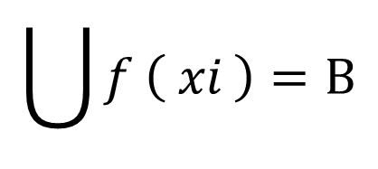
Onto function
Function is Onto if its range is the entire set B
  i.e.
$$\bigcup{f \left( xi \right)}=B$$

Slide 36
Bijection
The function which is one-to-one and Onto both is called a bijection from A to B.

Slide 37
Example
𝑓 : N → N 𝑓(x) = x² N = { 1 , 2 , 3 , …}
  On-to-one
    For every value of x you will get different value of 𝑓(x)
  Not Onto
    Some values of elements in co-domain are not assigned to any of the element in domain
1
2
3
4
.
.
.
1
2
3
4
.
.
.

Slide 38
Example
𝑓 : 2^{H}-{є} → H 𝑓(x) = Tallest person in set x
H = { p1 , p2 , p3 , … , p100 }
2^{H} = є , {p1} , {p2} , {p1,p2} , …
  Not One-to-one
    Can have same value of
    𝑓(x) for different
    value of x
  Onto
    Cover entire range of H
{p1}
{p2}
{p1,p2}
.
.
.
P1
P2
p3
.
.
.

Slide 39
Example
𝑓 : A → B 𝑓(x) = x+1
A = { 1 , 2 , 3 , … , n} B = { 2 , 3 , 4 , … , n+1}
  On-to-one
    For every value of x you will get different value of 𝑓(x)
  Onto
    All value of B is covered
  So it’s a bijection
  from A to B
1
2
3
.
.
.
n
2
3
4
.
.
.
n+1

Slide 40
Inverse function
𝑓 : A → B then 𝑓⁻¹ is called inverse function such that 𝑓⁻¹ : B → A
  𝑓 (x) = y where x∊A and y∊B then 𝑓⁻¹ (y) = x
So for all x∊A and y∊B
  𝑓⁻¹ ( 𝑓 ( x ) ) = x
  𝑓 ( 𝑓 ⁻¹ ( y ) ) = y

Slide 41
Operation on a set
An operation on a set A is a function that assigns to elements of A
  i.e. Domain and Codomain of function are same
  𝑓 : A → A
  𝑓 (x1) = x2 where x1 , x2 ∊ A

Slide 42
Content
1.1 Sets
1.2 Functions
1.3 Logical statements
1.4 Proofs, Relations, Languages
1.5 Mathematical induction,
Strong principle,
Recursive definitions

Slide 43
Definition
Relation R from A to B
in that an element x ∈ A may be related
to no elements of B,
to one element of B,
or to more than one element of B
Denoted by
  aRb : a related to b with respect to relation R

Slide 44
Example
A : people
B : city
R : has lived in
for x ∊ A and y ∊ B ,
xRy means x person has lived in y city
  x may never lived in given city
  x may lived in exactly one city for entire life
  x may lived in may cities

Slide 45
Relation on set(s)
Relation from A to B is subset of A x B
Relation on set A is a relation from A to A
or a subset of A x A

Slide 46
Equivalence relation
Relation R on a set A is an equivalence relation if it satisfies following properties
  R is reflective
    For every a ∊ A , aRa
  R is symmetric
    For every a and b in A if aRb then bRa
  R is transitive
    For a,b,c in A if aRb and bRc then aRc

Slide 47
Equivalence relation Example
In each case below, a relation on the set {1, 2, 3} is given. Of the three properties, reflexivity, symmetry, and transitivity, determine which ones
the relation has. Give reasons.
1) | R = { (1,3) , (3,1) , (2,2) }
2) | R = { (1,1) , (2,2) , (3,3) , (1,2) }
3) | R = Ø

✓

✓

✓

✓
✓
Reflexivity
Symmetry
Transitivity

Slide 48
Content
1.1 Sets
1.2 Functions
1.3 Logical statements
1.4 Proofs, Relations, Languages
1.5 Mathematical induction,
Strong principle,
Recursive definitions

Slide 49


Symbol & Alphabet
Symbol
  basic building block
  e.g. a-z , A-Z , 0-9 , + , * ,
Alphabet ( ∑ )
  Finite set of symbols
  Any number of symbols can possible in alphabet
  e.g. {a, b, c} {0, 1} {X, Y, Z} { , }

Slide 50
String
String
  Finite sequence of symbols available in alphabet
  e.g. ∑ = {a, b}
  possible strings can be
  a, aa, aaa, aaaa, …,
  b, bb, bbb, bbbb, …
  ab, ba, aab, aba, abb, ababbba, …
  Alphabet having “ | ∑ | ” symbols then
  Number of possible string of length “ N ” is | ∑ | ^{N}

Slide 51
String
String
  x is string then |x| is length of string
  String x over ∑ and element y∊∑
  n_{y}(x) = number of occurrence of the symbol y in
  string x

Slide 52
Order of string listing
Lexicographic order
  Alphabetical order of string
  E.g.
  a , aa , ab , b , ba , bb
Canonical order
  Sort by length & same length appear alphabetically
  E.g.
  a , b , aa , ab , ba , bb

Slide 53
String concatenation
X and Y are to strings over alphabet then
Concatenation of X and Y can be written as XY
Symbols of X followed by symbols of Y
  e.g.
  X = abc and Y = pqr
  XY = abcpqr

Slide 54
String concatenation
Support Associative law
  X ( YZ ) = ( XY ) Z
  e.g.
  X = ab Y = 123 Z = pqr
  YZ = 123pqr X (YZ) = ab123pqr
  XY = ab123 (XY) Z = ab123pqr
  X ( YZ ) = ( XY ) Z = XYZ

Slide 55
String concatenation
Does not support Commutative law
  XY ≠ YX
  e.g.
  X = abc Y = pqr
  XY = abcpqr
  YX = pqrabc

Slide 56
String concatenation
One of the string in concatenation is empty string of null string then result is another string itself
  If Y=∧ then XY = YX = X
Length of XY = length of X + length of Y
  |XY| = |X| + |Y| = |Y| + |X|

Slide 57
Prefix , Suffix , Substring
S₁ S₂ S₃ are tree string and string S = S₁S₂S₃ then
  S_{1 ,} S_{2 ,} S₃ all are Substring of S
  S₁ is Prefix of S
    (special case of substring, initial substring)
  S₃ is Suffix of S
    (special case of substring, final substring)

Slide 58
Prefix , Suffix , Substring
∧ (null string) is prefix, suffix and substring of every string
Every string is prefix, suffix and substring of itself

Slide 59
Language
Language (L)
  Set of strings over an alphabet of symbols
  ∑ = {a, b}
  L₁ = set of all string of length 2
  = {aa, ab, ba, bb} Finite
  L₂ = set of all string of length 3
  = {aaa, aab, aba, abb, bbb, bba, bab, baa} Finite
  L₃ = set of all strings start with a
  = {a, aa, ab, aaa, abb, aab, aba, …} Infinite

Slide 60
Operation on language
Language is set so all operation of set can be applied on Language as well
L₁ and L₂ are Language over alphabet ∑ then
L₁∪L₂ , L₁∩L₂ , L₁-L₂ etc. are also language over alphabet ∑

Slide 61
Universal set of languages ∑*
∑* is the set of all possible string over ∑
  ∑ = {a,b} then ∑* = {a,b}* = (a+b)*
  {a,b}* = {^ , a , b , aa , ab , ba , bb , aaa , aab , …}
A language L over ∑ is subset of ∑*
  L ⊆ ∑*
  ∴ L’ = ∑* - L

Slide 62
Content
1.1 Sets
1.2 Functions
1.3 Logical statements
1.4 Proofs, Relations, Languages
1.5 Mathematical induction,
Strong principle,
Recursive definitions

Slide 63
Introduction
Proof of a statement is just a convincing argument that the statement is true
A typical step in proof is to derive some statement from
  Assumption / hypotheses
  Statements that already been derived
  Other generally accepted facts
using general principles of logical reasoning

Slide 64
Types
Constructive proof
Contrapositive proof
Contradiction proof
Proof by counter example

Slide 65
(1) Constructive proof example
If A and B are odd number then AB is odd
  A and B are odd
  A = 2m+1 and B = 2n+1
  AB = (2m+1) (2n+1)
  = 4mn + 2m + 2n + 1
  = 2 (2mn + m + n) + 1
  = 2k+1 (assume 2mn+m+n=k)
  odd number
  ∴If A and B are odd number then AB is odd

Slide 66
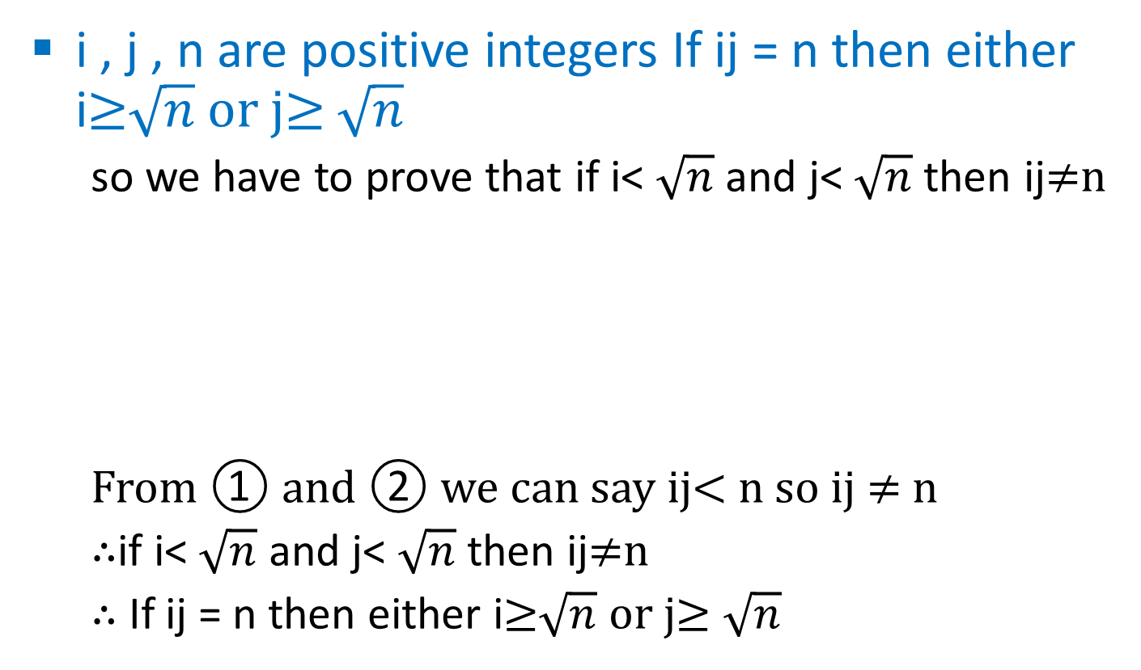
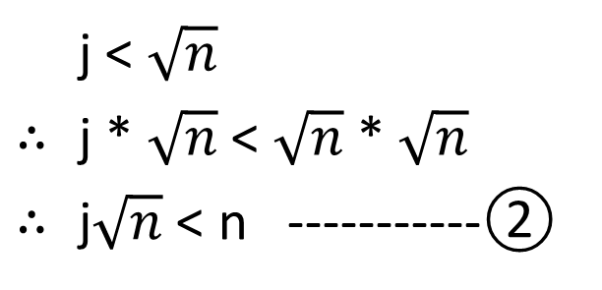
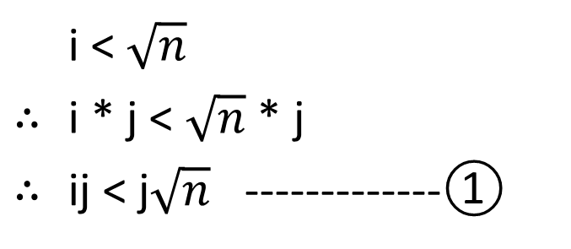
(2) Contrapositive proof example
i , j , n are positive integers If ij = n then either i≥$\sqrt{n}$ or j≥ $\sqrt{n}$
  so we have to prove that if i< $\sqrt{n}$ and j< $\sqrt{n}$ then ij≠n
  From ① and ② we can say ij< n so ij ≠ n
  ∴if i< $\sqrt{n}$ and j< $\sqrt{n}$ then ij≠n
  ∴ If ij = n then either i≥$\sqrt{n}$ or j≥ $\sqrt{n}$
 | i < $\sqrt{n}$
∴ | i * j < $\sqrt{n}$ * j
∴ | ij < j$\sqrt{n}$ -------------①
 | j < $\sqrt{n}$
∴ | j * $\sqrt{n}$ < $\sqrt{n}$ * $\sqrt{n}$
∴ | j$\sqrt{n}$ < n -----------②
Notes:
∴ for ALT +8756
∵ for ALT +8757

Slide 67
(3) Contradiction proof example
For set A, B, C if A∩B=∅ and C⊆B then A∩C= ∅
  Assume reverse A∩C ≠ ∅
  ∴ ∃x such that x ∊ A and x ∊ C
  Now C ⊆ B so x ∊ B
  ∴ x ∊ A and x ∊ B
  ∴ A∩B ≠ ∅
  Which is contradict to our statement A∩B=∅
  ∴ if A∩B=∅ and C⊆B then A∩C= ∅

Slide 68
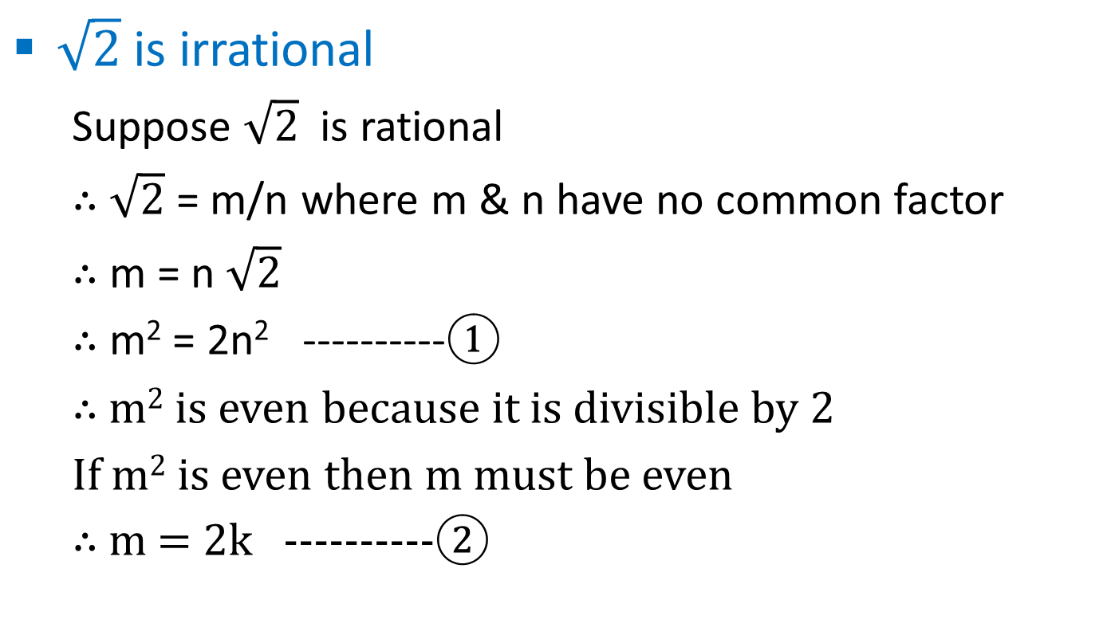
(3) Contradiction proof example
$\sqrt{2}$ is irrational
  Suppose $\sqrt{2}$ is rational
  ∴ $\sqrt{2}$ = m/n where m & n have no common factor
  ∴ m = n $\sqrt{2}$
  ∴ m² = 2n² ----------①
  ∴ m² is even because it is divisible by 2
  If m² is even then m must be even
  ∴ m = 2k ----------②

Slide 69
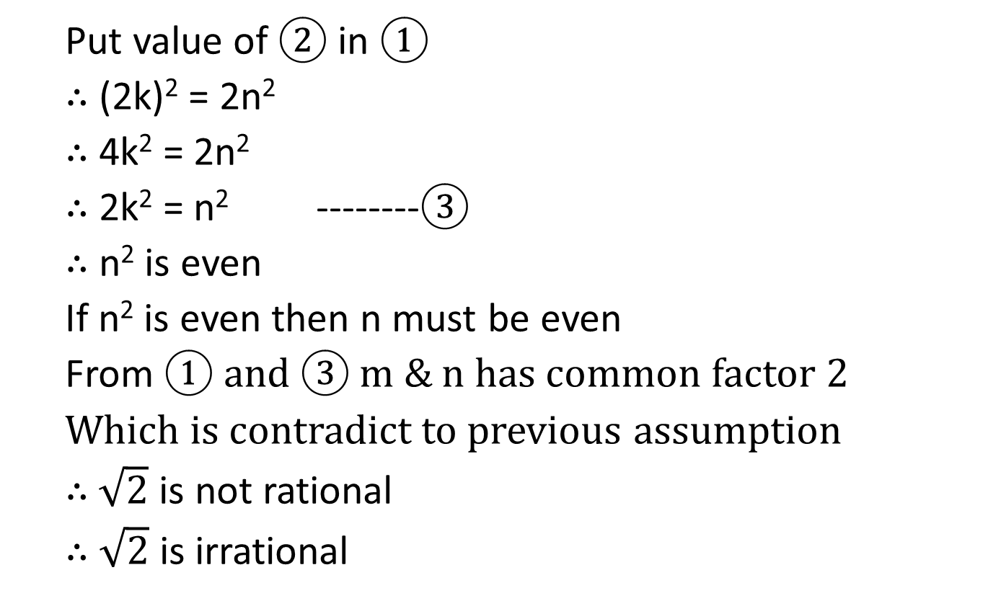
(3) Contradiction proof example
  Put value of ② in ①
  ∴ (2k)² = 2n²
  ∴ 4k² = 2n²
  ∴ 2k² = n² --------③
  ∴ n² is even
  If n² is even then n must be even
  From ① and ③ m & n has common factor 2
  Which is contradict to previous assumption
  ∴ $\sqrt{2}$ is not rational
  ∴ $\sqrt{2}$ is irrational

Slide 70
Content
1.1 Sets
1.2 Functions
1.3 Logical statements
1.4 Proofs, Relations, Languages
1.5 Mathematical induction,
Strong principle,
Recursive definitions

Slide 71
Principle of mathematical induction
Suppose P(n) is a statement involving an integer n. then to prove that P(n) is true for every n≥n₀, it is sufficient to show these two things:
  P(n₀) is true
  For any k≥n₀, if P(k) is true , then P(k+1) is true

Slide 72
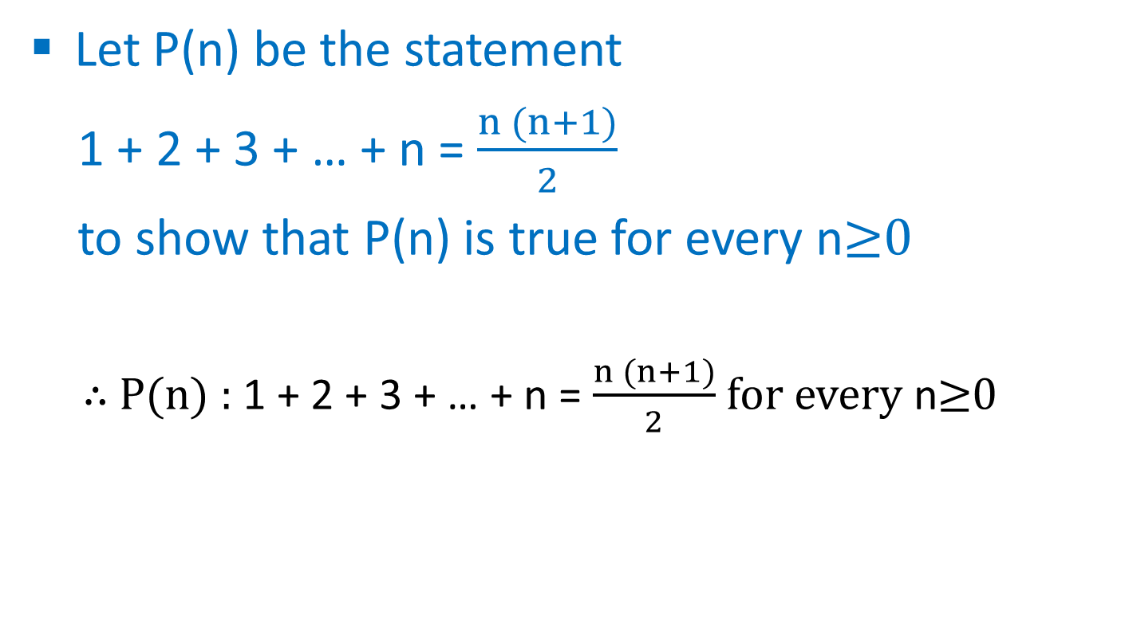
Example
Let P(n) be the statement
1 + 2 + 3 + … + n = $\frac{n (n+1)}{2}$
to show that P(n) is true for every n≥0
  ∴ P(n) : 1 + 2 + 3 + … + n = $\frac{n (n+1)}{2}$ for every n≥0

Slide 73
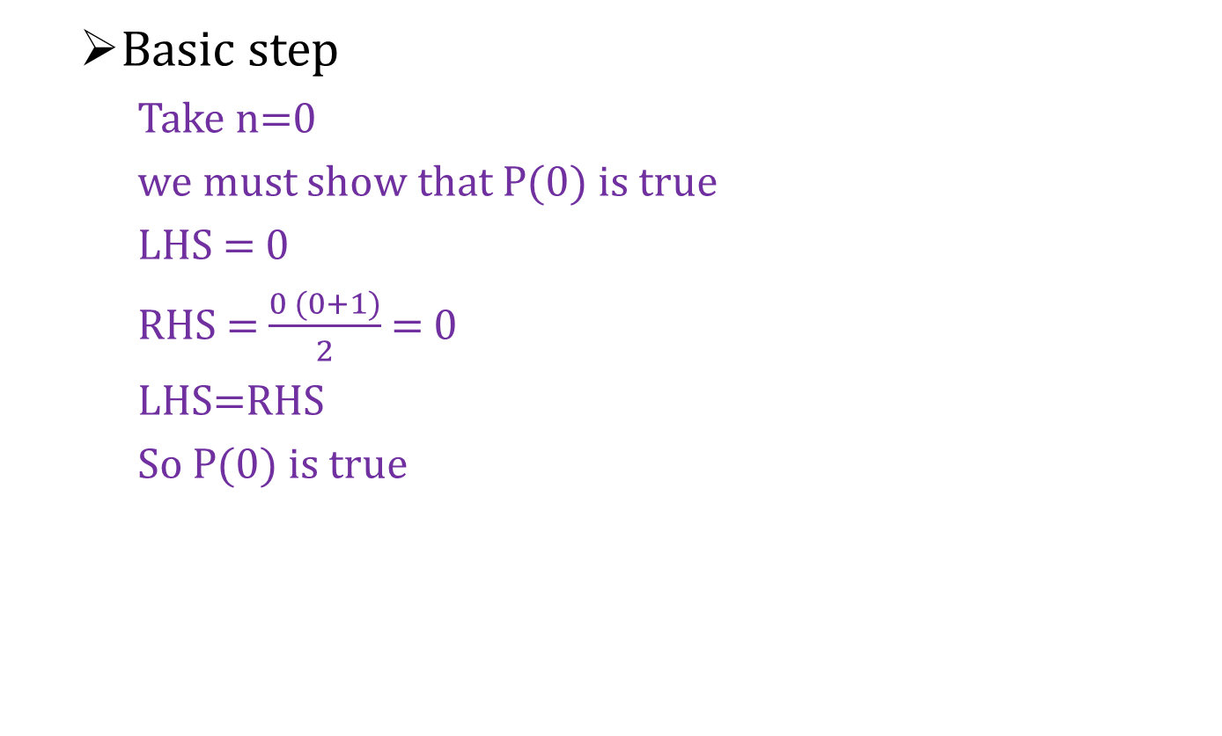
Example
  Basic step
    Take n=0
    we must show that P(0) is true
    LHS = 0
    RHS = $\frac{0 (0+1)}{2}$ = 0
    LHS=RHS
    So P(0) is true

Slide 74
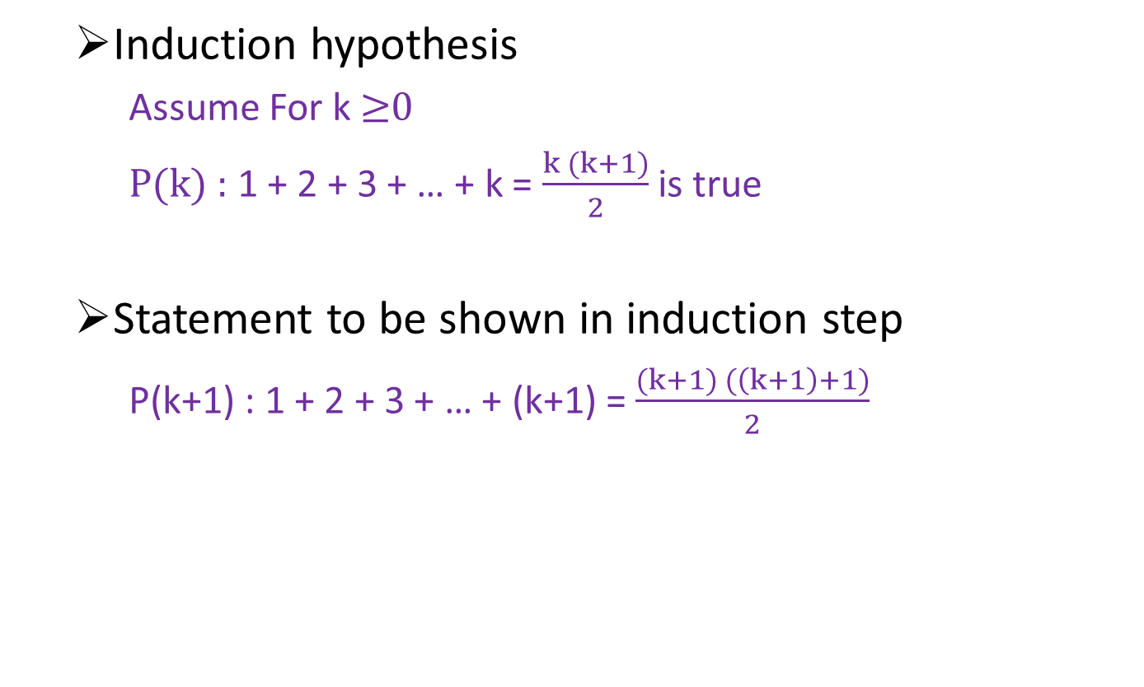
Example
  Induction hypothesis
    Assume For k ≥0
    P(k) : 1 + 2 + 3 + … + k = $\frac{k (k+1)}{2}$ is true
  Statement to be shown in induction step
    P(k+1) : 1 + 2 + 3 + … + (k+1) = $\frac{(k+1) (\left(k+1\right)+1)}{2}$

Slide 75
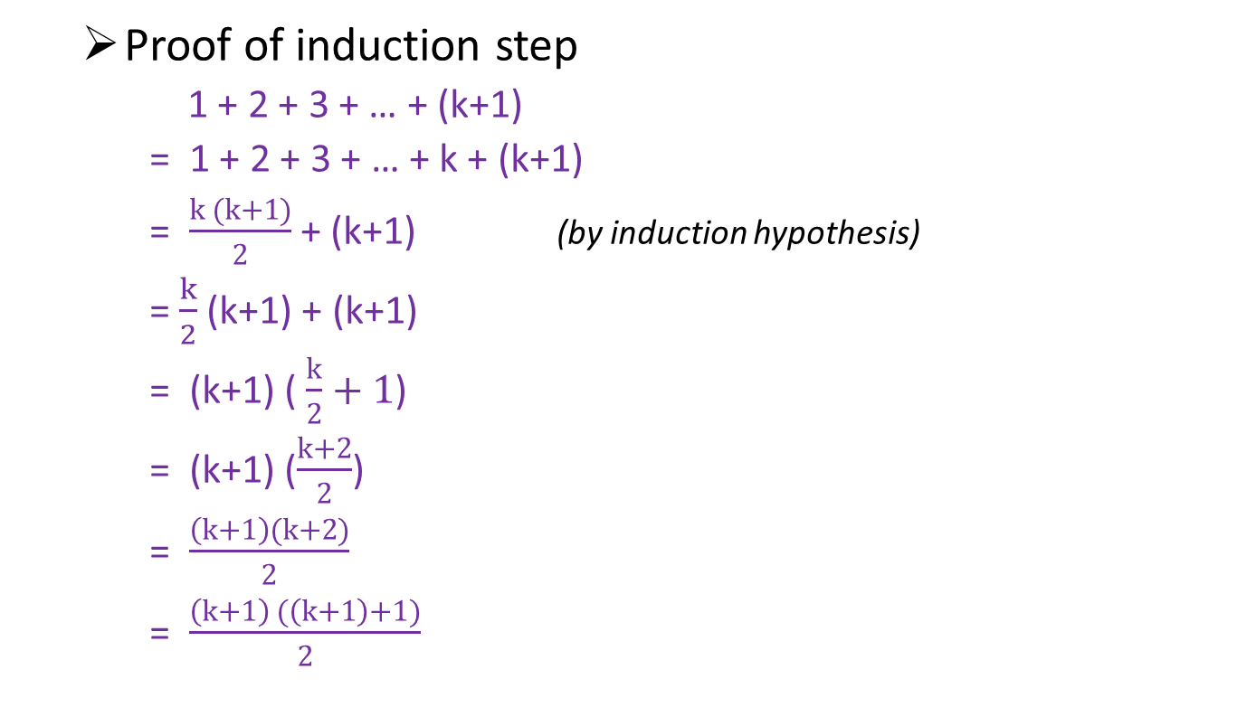
Example
  Proof of induction step
    1 + 2 + 3 + … + (k+1)
    = 1 + 2 + 3 + … + k + (k+1)
    = $\frac{k (k+1)}{2}$ + (k+1) (by induction hypothesis)
    =$\frac{k}{2}$ (k+1) + (k+1)
    = (k+1) ( $\frac{k}{2}+1$)
    = (k+1) ($\frac{k+2}{2}$)
    = $\frac{\left(k+1\right)(k+2)}{2}$
    = $\frac{\left(k+1\right) (\left(k+1\right)+1)}{2}$

Slide 76
Example
    So P(k+1) is true.
    So P(n) is true for every n ≥ 0

Slide 77
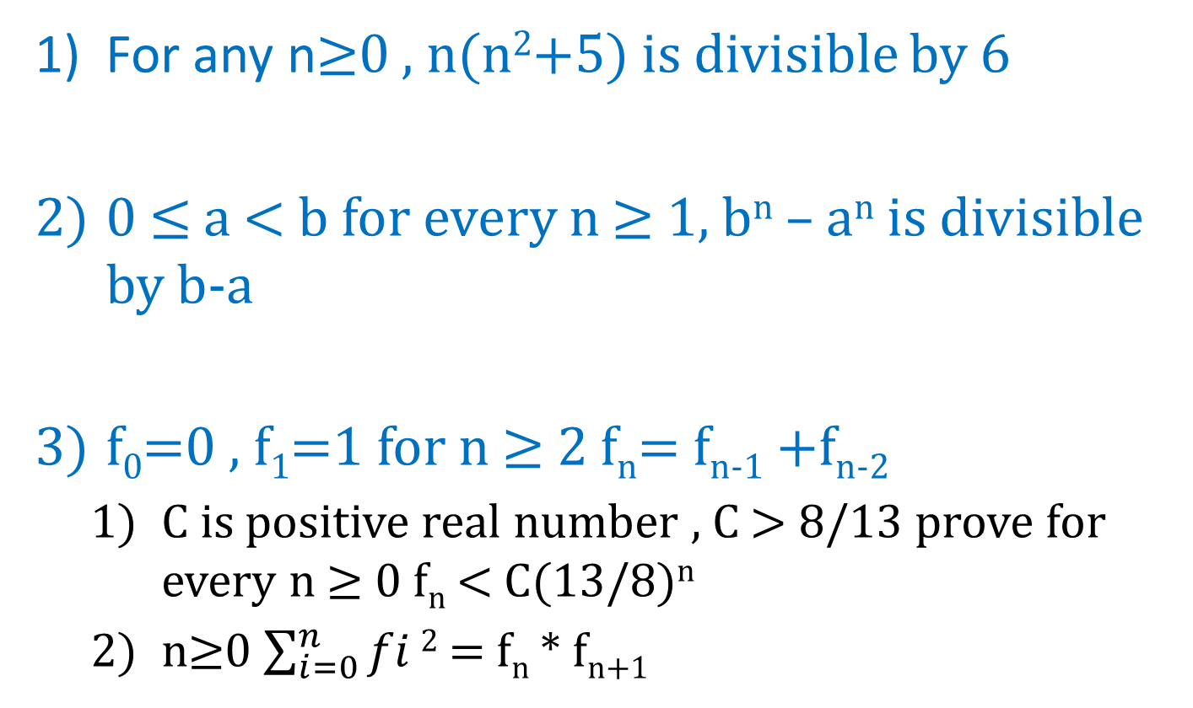
Examples
For any n≥0 , n(n²+5) is divisible by 6
0 ≤ a < b for every n ≥ 1, b^{n} – a^{n} is divisible by b-a
f₀=0 , f₁=1 for n ≥ 2 f_{n}= f_{n-1} +f_{n-2}
  C is positive real number , C > 8/13 prove for every n ≥ 0 f_{n} < C(13/8)^{n}
  n≥0 $\sum_{i=0}^{n}{fi}2$ = f_{n} * f_{n+1}

Slide 78
Examples
for every n≥0 , n is either odd or even but not both
Sum of cube of three consecutive integers is divisible by 9
String of the form 0y1 must contain he substring 01

Slide 79
Examples
Y = 1
for i = 1 to n
Y = Y * X;
write (Y)
we like to show that when code is executed,
the value printed out is x^{n}

Slide 80
Examples
P(n) = n is either a prime or a product of two or more prime for n≥2
For any n≥4 , n! > 2^{n}
Every nonempty subset of N the set of natural numbers has a smallest element
(The Well-ordering Principle for the Natural Number)

Slide 81
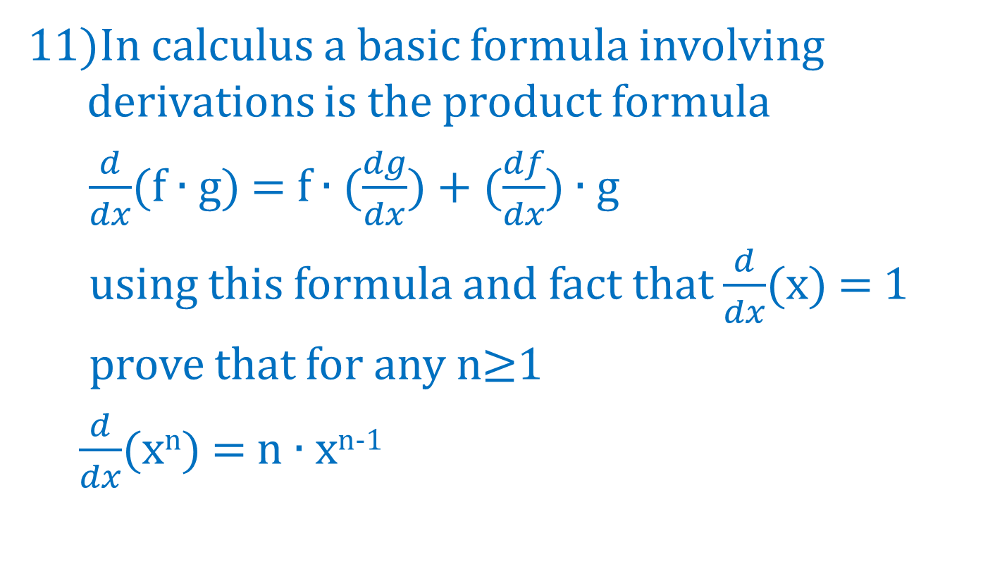
Examples
In calculus a basic formula involving derivations is the product formula
$\frac{d}{dx}$(f ∙ g) = f ∙ ($\frac{dg}{dx}$) + ($\frac{df}{dx}$) ∙ g
using this formula and fact that $\frac{d}{dx}$(x) = 1
prove that for any n≥1
$\frac{d}{dx}$(x^{n}) = n ∙ x^{n-1}

Slide 82
Content
1.1 Sets
1.2 Functions
1.3 Logical statements
1.4 Proofs, Relations, Languages
1.5 Mathematical induction,
Strong principle,
Recursive definitions

Slide 83
Strong principle of mathematical induction
Suppose P(n) is a statement involving an integer n. Then to prove that P(n) is true for every n≥n₀, it is sufficient to show these two things
  P(n₀) is true
  For any k≥n₀, if P(n) is true for every n satisfying n₀≤n≤k, then P(k+1) is true

Slide 84
Example
P(n) is true for every n≥2, where P(n) is the statement: n is either a prime or a product of two or more primes
  Basic step
    P(2) : 2 is either a prime or a product of two or more prime
    Statement is true as 2 is prime number

Slide 85
Example
  Induction hypothesis
    k≥2 and for every 2≤n≤k, n
    P(k) : k is either prime or product of two or more primes
  Statement to be shown in induction step
    P(k+1) : k+1 is either prime or product of two or more primes

Slide 86
Example
  Proof of induction step
    If k+1 is prime
    Then the statement is true
    If k+1 is not prime
    ∴k+1 has factors A and B which is neither 1 nor k+1
    ∴k+1 = A * B
    where 2≤A≤k and 2≤B≤k
    now according to induction hypothesis A and B are either prime or product of two or more prime
    ∴ their product k+1 is also product of two or more prime

Slide 87
Content
1.1 Sets
1.2 Functions
1.3 Logical statements
1.4 Proofs, Relations, Languages
1.5 Mathematical induction,
Strong principle,
Recursive definitions

Slide 88
Recursive definition
Can use recursion as a tool for defining sets:
  Sets of numbers
  Sets of strings
  Sets of sets

Slide 89
Recursive definition
Steps to write Recursive definition of set
  Basic statement
    Specifies one or more elements in a set
  Recursive part
    Involves one or more operations (can be applied to elements already known to be in the set) to produce new element

Slide 90
RD of set of natural number N
0 ∊ N
For every n ∊ N , n+1 ∊ N
Every element of N can be obtained by using statement-1 or statement-2

Slide 91
RD of some subset of N
Let A ⊂ N such that
  15 ∊ A
  For every n ∊ A , n+1 ∊ A
Let B ⊂ N such that
  1 ∊ B
  For every n ∊ B , 2*n ∊ B
  For every n ∊ B , 5*n ∊ B

Slide 92
RD of {a,b}*
Є ∊ {a,b}*
For every x ∊ {a,b}* , both xa and xb are in {a,b}*

Slide 93
RD of Language
We let L be the language
L = { a^{n}b^{n} | n ∊ N }
  Є ∊ L
  For every x ∊ L , axb ∊ L

Slide 94
RD of algebraic expression & balanced string of parenthesis
a ∊ Expr
For every X and every Y in Expr , X+Y and X*Y are in Expr
For every X ∊ Expr , (X) ∊ Expr

Slide 95
RD of Factorial
1! = 1
Foe every n>0 , n! = n*(n-1)!
RD of Fibonacci
f(0) = 1 , f(1) =1
For every n≥1 , f(n+1)=f(n)+f(n-1)

Slide 96
RD of L*
Є ∊ L*
For any x∊L* and y∊L* then xy∊L*
RD of Transitive clouser of a relation
R⊆R^{t}
For any x, y, z ∊ S if (x,y) ∊R^{t} and (y,z) ∊R^{t} then (x,z) ∊R^{t}

Slide 97
RD of Palindrome
Є ∊P
For any a∊∑ , a∊P
For any x∊P and a ∊ ∑ , axa∊P
P : palindrome set
∑ : alphabet

Slide 98
Content
1.1 Sets
1.2 Functions
1.3 Logical statements
1.4 Proofs, Relations, Languages
1.5 Mathematical induction,
Strong principle,
Recursive definitions
End
of
Unit-2

